Slide 1

GENERAL SURVEY REPORT (2024)
Lawal Fatimah Titilope
June, 2025.

Slide 2

INTRODUCTION
This survey aimed to explore online habits, app preferences and financial behaviors across diverse demographics.
It examined key factors such as the hours spent online, amount spent on data weekly, preferred social media platforms and financial metrics like income, expenses and savings.
The respondents for this survey include individuals from different age groups and genders. This presentation will highlight the major findings from the survey, offering insights that can guide strategic.

Slide 3
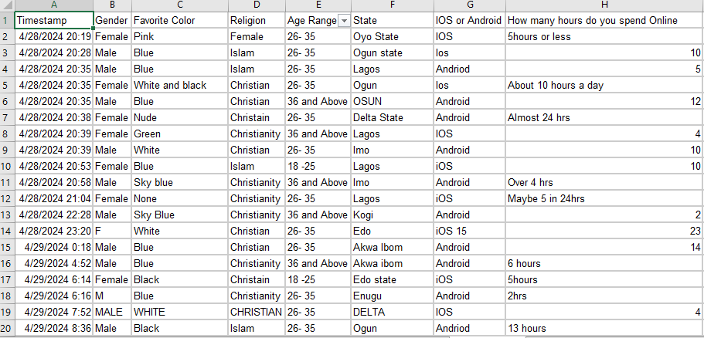
RAW DATASET

Slide 4
PROCESS WORKFLOW
DATA CLEANING
ANALYSIS
&
INSIGHTS
DATA VISUALIZATION
CONCLUSIONS
& RECOMMENDATIONS

Slide 5
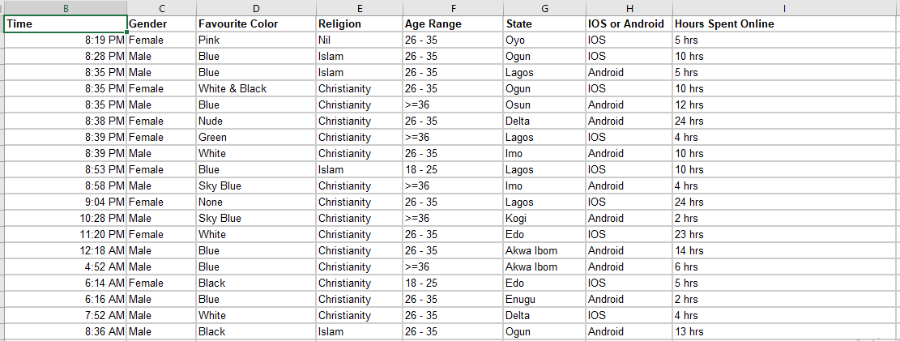
CLEANED DATASET

Slide 6
DATA CLEANING PROCESS
The dataset was thoroughly checked for duplicates and blank entries but none were found.
Two rows containing irrelevant data were identified and completely removed to ensure the dataset’s integrity.
All columns were properly formatted and the dataset was organised into a standard excel worksheet for further analysis.

Slide 7
ANALYSIS & INSIGHTS
No of Respondents
132
Average Monthly Income
#280,183
Average Hours Spent Online
9.8
Most Used App
WhatsApp
Average Data Expenditure
#21,240
Average Monthly Savings
#68,196

Slide 8
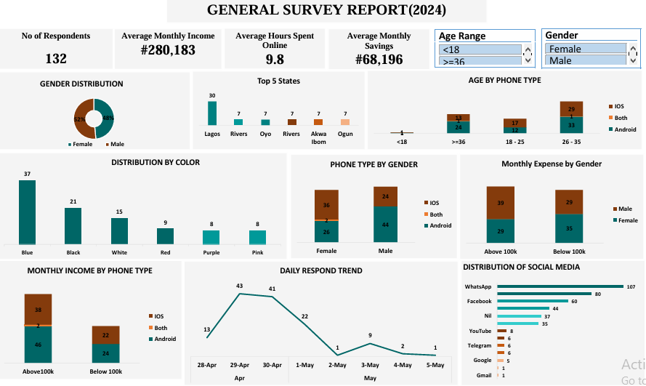
DATA VISUALIZATION

Slide 9
CONCLUSION
These insights provide a clear understanding of the respondents’ lifestyles, preferences and financial habits. Organizations such as financial institutions, telecom companies, social media platforms and tech firms can leverage this data to make informed decisions and tailor their strategies effectively.

Slide 10
RCOMMENDATION
Financial Institutions can develop flexible savings and investment plans targeted at younger demographics who spend significant time online.
Telecom companies should introduce affordable data plans for users with high daily online activity.
Social media platforms should enhance user engage strategies by focusing on features that align with WhatsApp’s popularity among respondents.
Tech companies should consider age and preferences in phone type and color to guide product design.

Slide 11
THANK YOU

